Slide 1
Project Title: Analyses of Global Environmental, Healthcare Dynamics, and Socioeconomic Interdependencies Course: FA550 Data Visualization Application Semester: Fall 2023
Presented by:
Name: Riddhi Mahesh Dange
CWID: 20012299

Slide 2
INTRODUCTION
In today's interconnected world, it is crucial to understand the complex relationships between environmental factors, socioeconomic indicators, and educational dynamics. This research project aims to explore these interdependencies using a data-driven approach to unravel the intricacies of global development. The project focuses on interconnected themes: the environment, demographics, healthcare, and education. By examining the correlation between forested area, fertility rates, CO2 emissions, and economic indicators, we aim to shed light on the complex factors that shape the trajectory of nations. Additionally, our study investigates the profound link between education and income inequality, providing insights into how educational levels and government policies affect wealth distribution within societies. The project's multidimensional approach seeks to analyze these phenomena individually and identify overarching patterns that govern the global socio-environmental and economic landscape. Through rigorous data analysis, dynamic visualizations, and a synthesis of findings from global databases, this project aims to contribute valuable insights to the discussion on sustainable development. By exploring environmental sustainability, demographic transitions, and educational imperatives, the project seeks to illuminate pathways toward a more equitable and informed global future.

Slide 3
Research Questions
How does the percentage of forested area correlate with a country's GDP?
What impact does the fertility rate have on a country's economic indicators, specifically GDP and CPI?
What is the relationship between a country's CO2 emissions and the life expectancy of its population, and how have environmental policies influenced this connection?
How does different levels of healthcare expenditure affect life expectancy across countries?
What is the relationship between education levels and economic growth?
What factors influence the adoption of clean energy technologies and the reduction of CO2 emissions across countries?

Slide 4
Visualization Tools
I have chosen to harness the dynamic visualization capabilities and ease of creating interactive dashboards in Tableau for my project. In parallel, I will employ R for its robust statistical analysis and custom visualization capabilities. Tableau for Dynamic Exploration: Utilize Tableau for dynamic scatter plots, grouped bar charts, bubble plots, scatter plots with color variation, and clustered bar charts. Leverage its user-friendly interface for interactive exploration. R for In-Depth Analysis: Employ ggplot2 in R for detailed scatter plots, box plots, line charts, stacked bar charts and bubble charts analysis. R's statistical capabilities provide insights into correlations and relationships.

Slide 5
Visualization Methods
R Code Visualizations:
Correlation between Forested Area Percentage and GDP:
Scatter plot with a trend line to visualize the correlation between forested area percentage and GDP.
Fertility Rate Impact on GDP and CPI:
Two scatter plots showing the impact of fertility rate on GDP and CPI.
A boxplot illustrating the distribution of fertility rates.
Relationship between CO2 Emissions and Life Expectancy:
Scatter plot with a trend line for the relationship between CO2 emissions and life expectancy.
Bubble chart depicting investment in healthcare infrastructure for high CO2 emission countries.
Healthcare Expenditure Impact on Life Expectancy:
Scatter plot with a trend line to show the impact of healthcare expenditure on life expectancy.
Line chart depicting the correlation between out-of-pocket health expenditure and life expectancy.
Scatter plot with size and color variations to visualize the impact of access to healthcare services on life expectancy.
Relationship between Education Levels and Economic Growth:
Scatter plot with a trend line to explore the relationship between primary education enrollment and GDP.
Factors Influencing Clean Energy Adoption:
Bubble chart showing factors influencing clean energy adoption with GDP and CO2 emissions.
Stacked bar chart illustrating factors influencing clean energy adoption and CO2 emissions reduction across countries.

Slide 6
Visualization Methods Continued
Tableau Visualizations:
Forested Area and GDP:
Scatter plot and geographical map showcasing the correlation between forested area and GDP.
Fertility Rate and Economic Factors:
Grouped bar chart and line chart illustrating the impact of fertility rate on economic factors.
CO2 Emissions and Life Expectancy:
Scatter plot and scatter plot vs line plot for CO2 emissions and life expectancy.
Geographical map visualizing CO2 emissions globally.
Healthcare Expenditure and Life Expectancy:
Scatter plot and bar chart depicting the relationship between healthcare expenditure and life expectancy.
Education Levels and Economic Growth:
Line plot and bubble chart showcasing the relationship between education levels and economic growth.
Clean Energy Adoption:
Tree map visualizing factors influencing clean energy adoption and CO2 emissions reduction.
These visualizations provide a comprehensive exploration of the dataset, combining dynamic and interactive features for better insights. The use of both R and Tableau ensures a balanced approach, leveraging the strengths of each tool for statistical analysis and visualization, respectively.

Slide 7
Project Schedule
11/15: Detailed proposal completed and ready for submission, including research questions and initial visualization plan stating visualization tools & methods, and dataset identification.
11/22: Datasets identified, initial cleaning complete, and evaluation and implementation of rational graph types.
11/27: Creating graphs on Tableau and R using required packages and libraries and interpretation of the graphs.
12 / 04: Draft a story narrative in R and tableau; addressing research questions complete. Start assembly of presentation.
12/12: Draft presentation completion and ready for review; identification of strengths and weaknesses for further rework.

Slide 8
Data Description & Source
Data Source: Kaggle datasets on global population, economics, environment, and healthcare metrics. https://www.kaggle.com/datasets/nelgiriyewithana/countries-of-the-world-2023
Key Variables: Utilizing fertility rate, CO2 emissions, GDP, and forested area percentage.
Dataset Overview:
Comprehensive global dataset for demographics, economics, environment, and healthcare.
Enables cross-country comparisons and detailed analysis.
Rich dataset for diverse insights and decision-making.
Analytical Potential and examples of insights:
Explore forested area-GDP correlation for sustainable forestry practices.
Analyze fertility rates' impact on economic indicators for informed policies.
Investigate CO2 emissions, life expectancy, and environmental policies for climate and healthcare insights.
Assess healthcare expenditure on life expectancy for reform strategies.
Explore education levels and economic growth linkage for policy guidance.
Analyze economic factors' impact on clean energy adoption for sustainable energy policies.

Slide 9
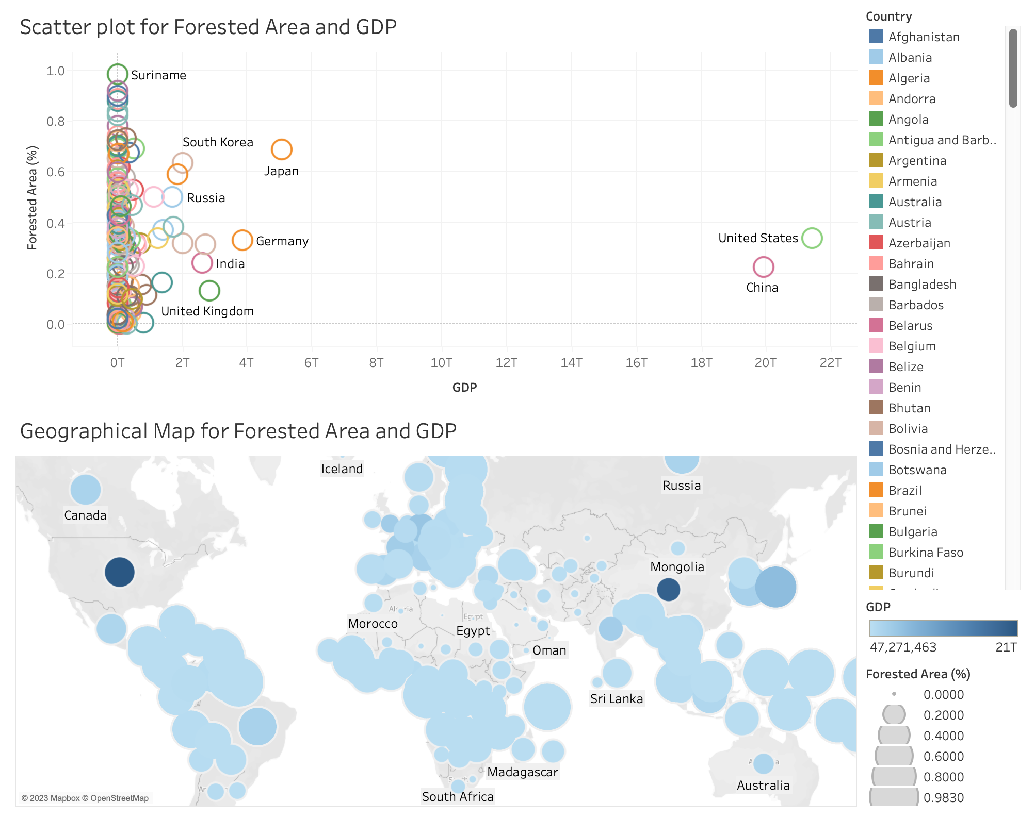
RESEARCH QUESTION 1: CORRELATION OF FORESTED AREA AND GDP IN TABLEAU

Slide 10
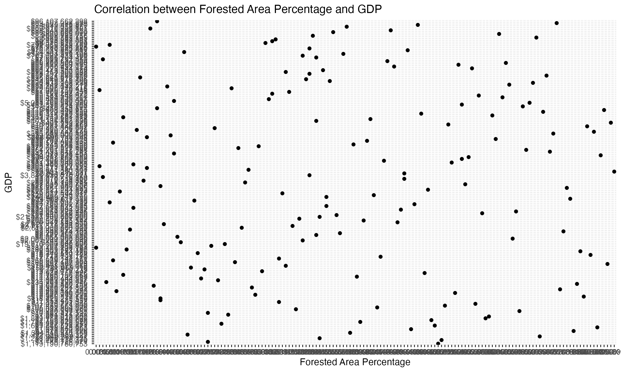
RESEARCH QUESTION 1: CORRELATION OF FORESTED AREA AND GDP IN R

Slide 11
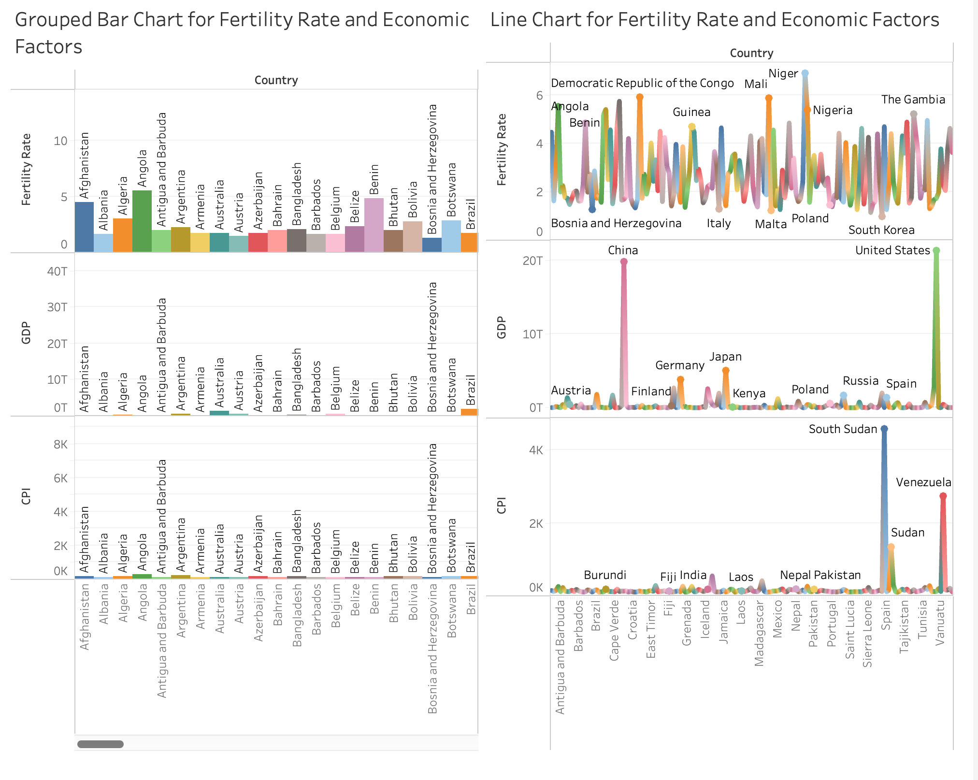
RESEARCH QUESTION 2: IMPACT OF FERTILITY RATE ON ECONOMIC FACTORS IN TABLEAU

Slide 12
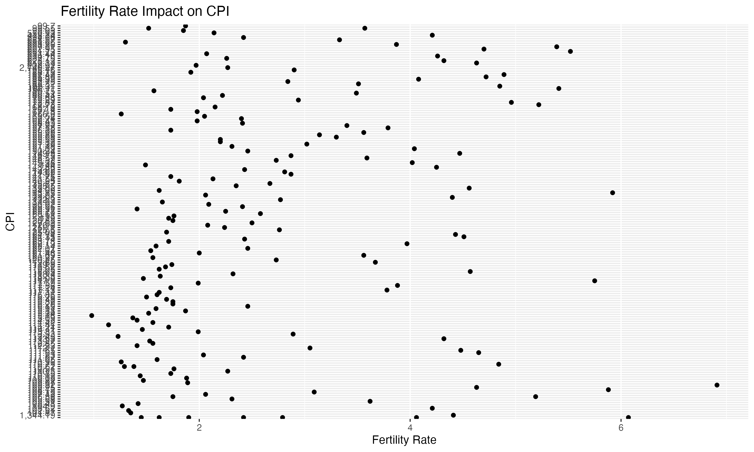
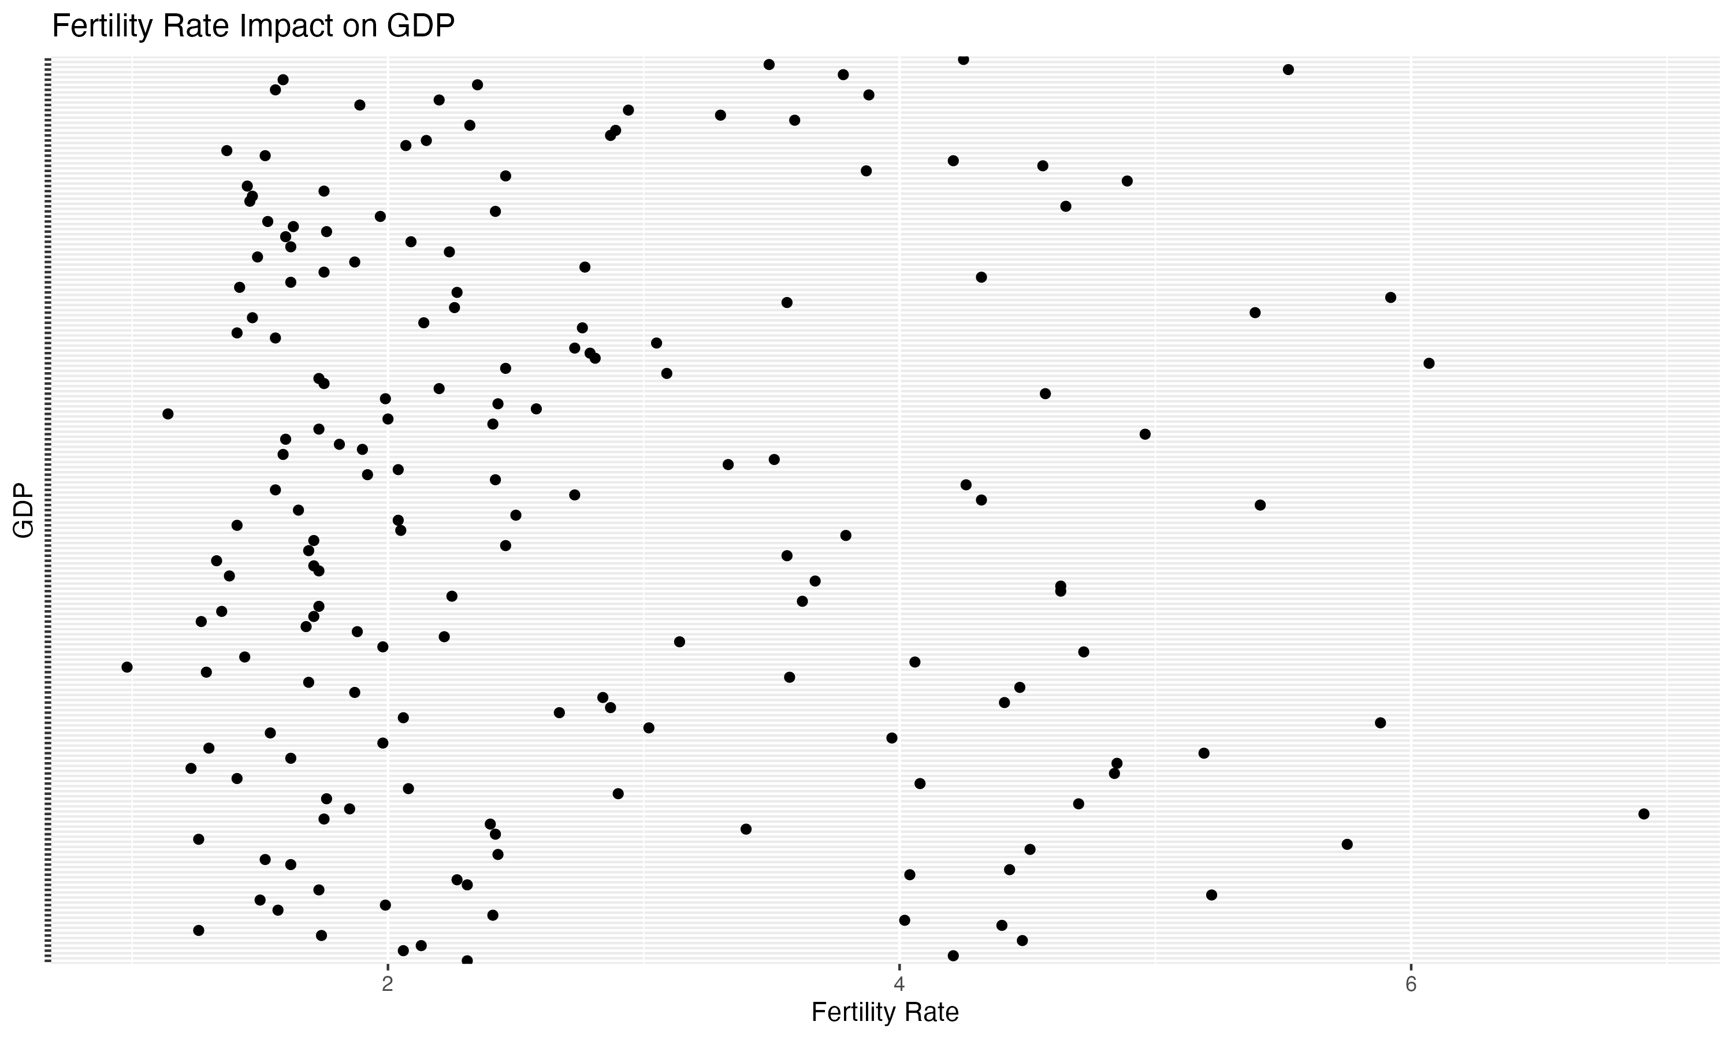
RESEARCH QUESTION 2: IMPACT OF FERTILITY RATE ON ECONOMIC FACTORS IN R

Slide 13
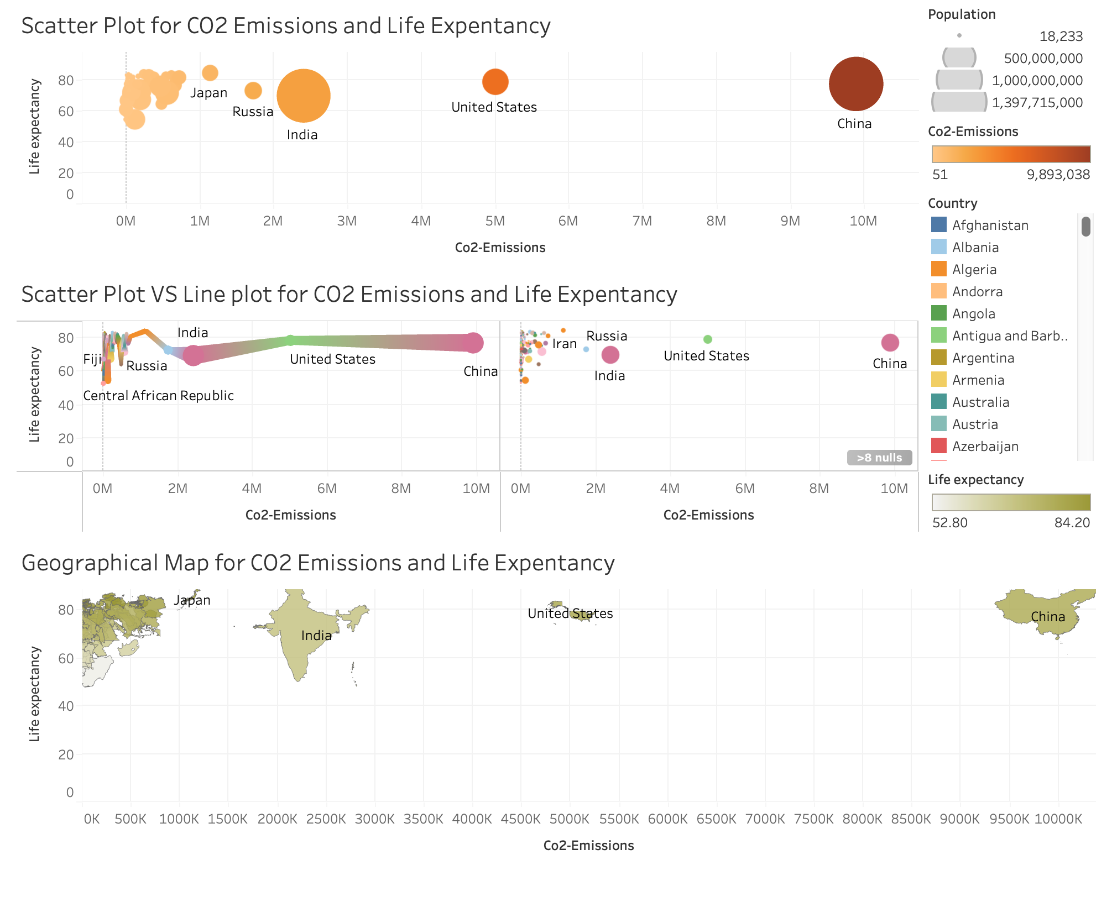
RESEARCH QUESTION 3 : RELATIONSHIP BETWEEN COUNTRY’S CO2 EMISSIONS AND LIFE EXPECTANCY IN TABLEAU

Slide 14
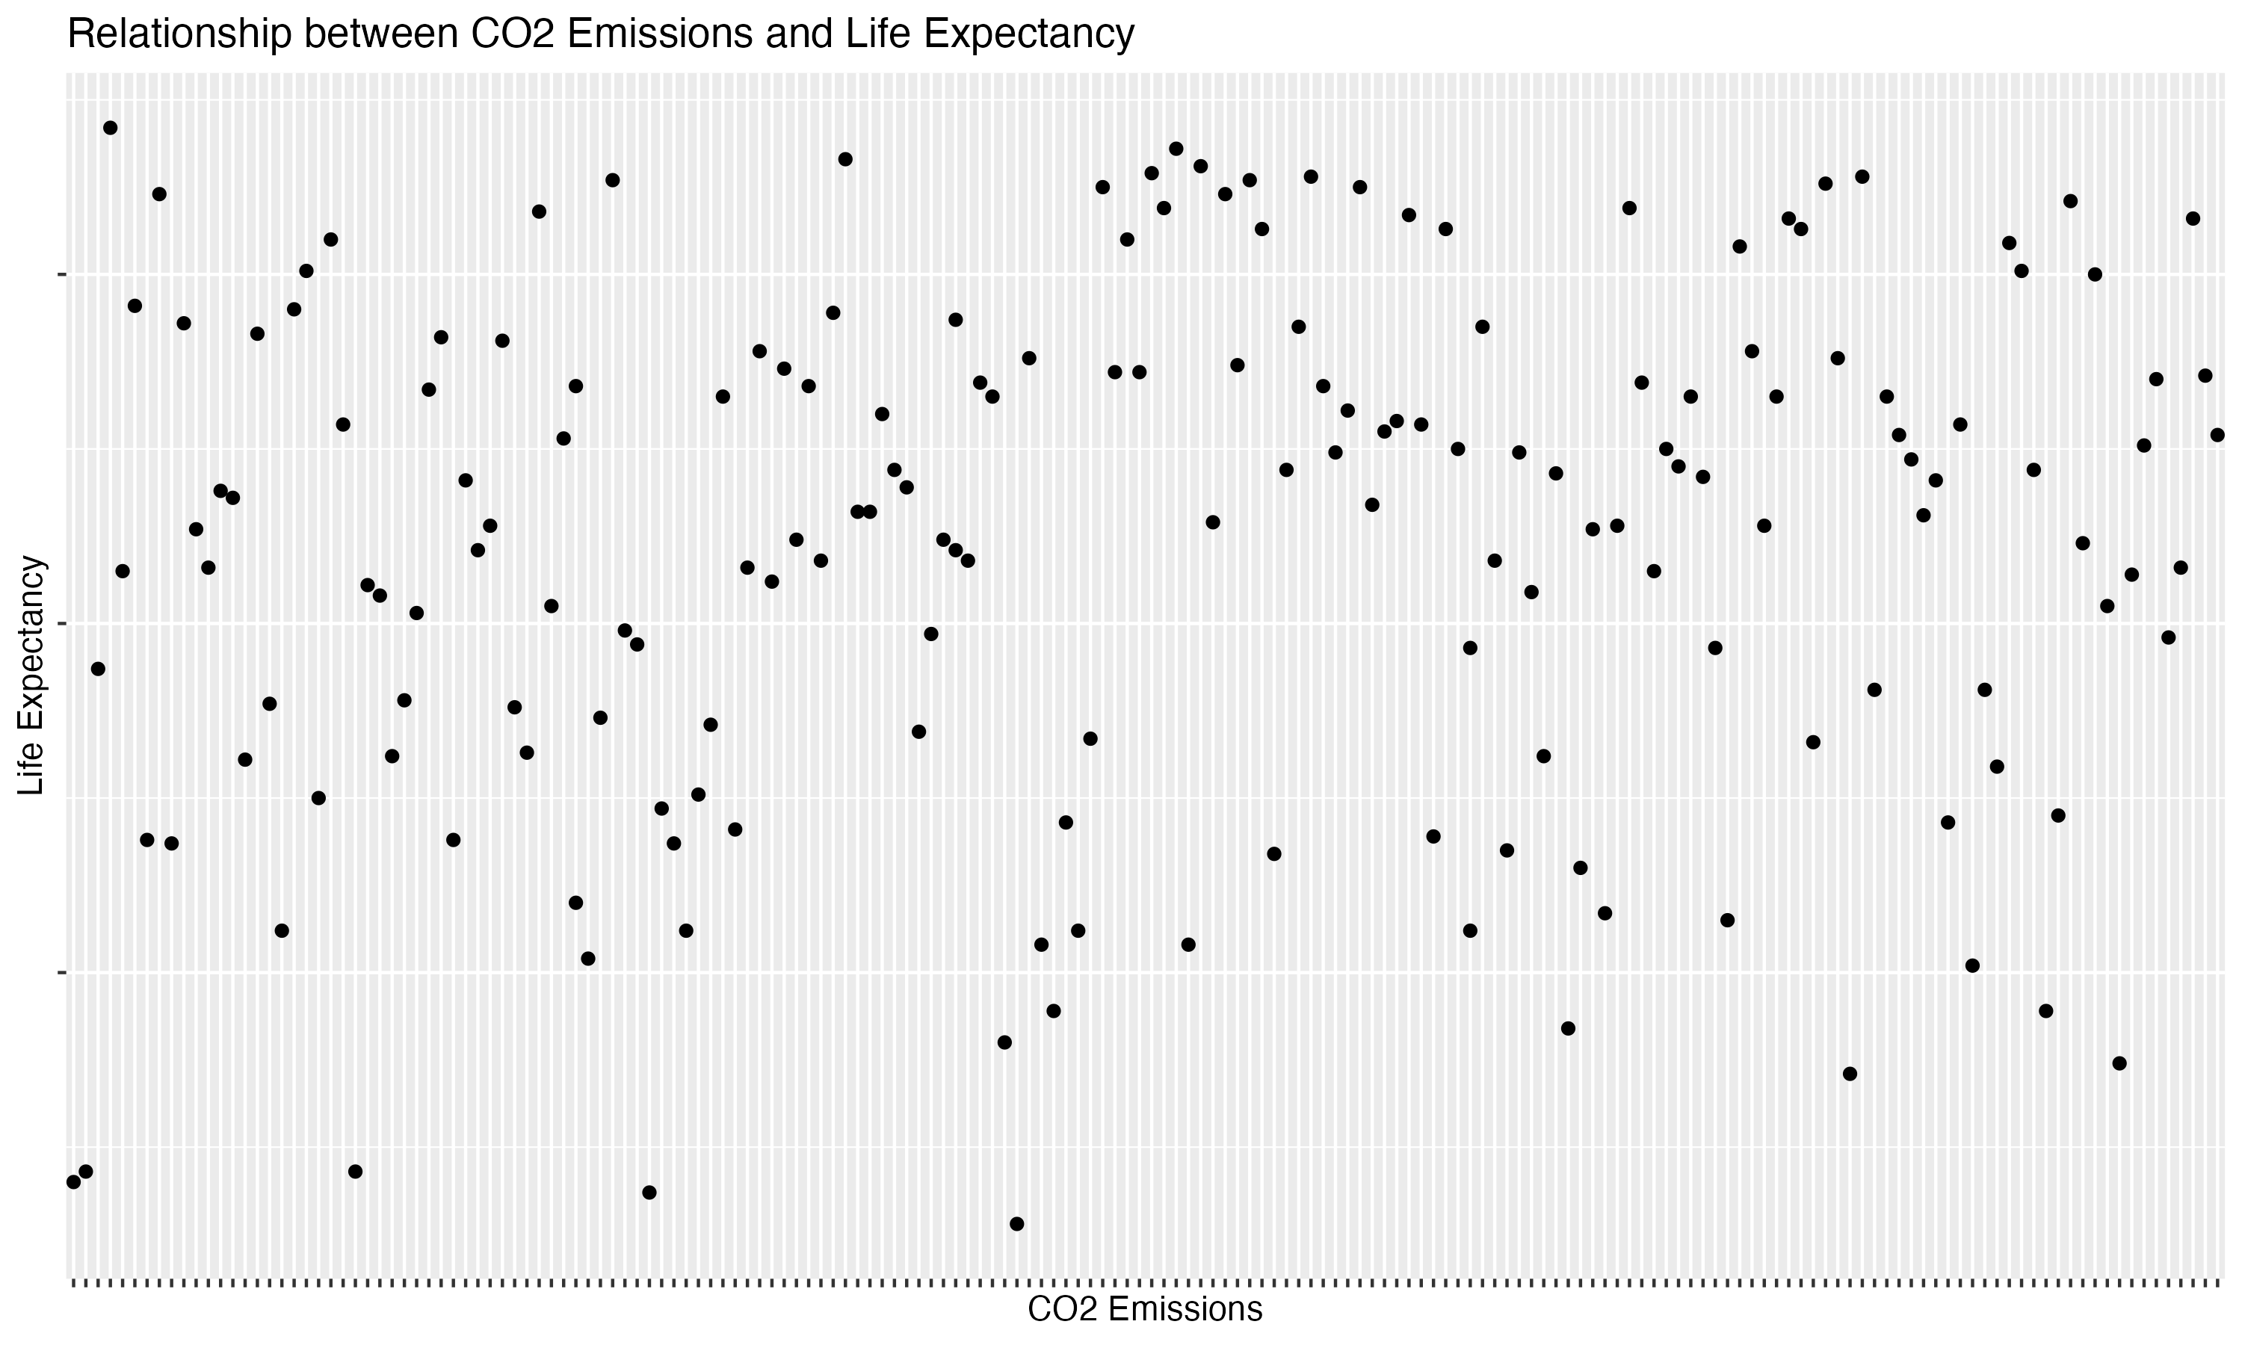
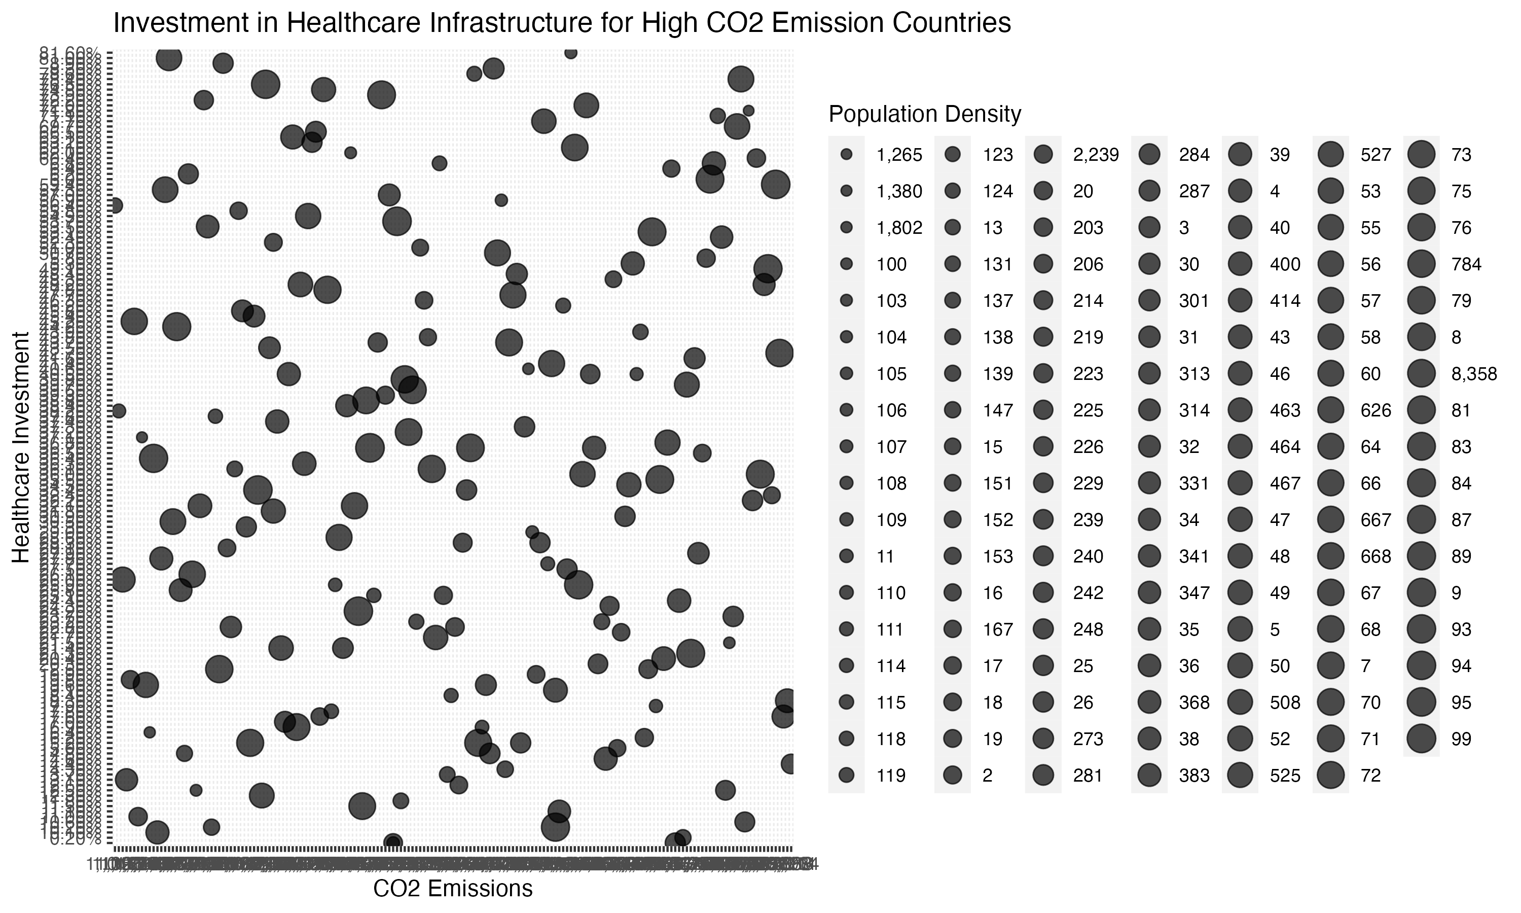
RESEARCH QUESTION 3 : RELATIONSHIP BETWEEN COUNTRY’S CO2 EMISSIONS AND LIFE EXPECTANCY IN R

Slide 15
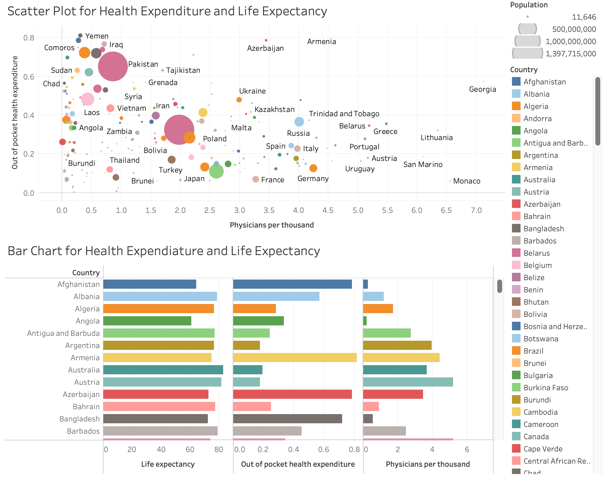
RESEARCH QUESTION 4 : EFFECT OF HEALTHCARE EXPENDITURE ON LIFE EXPECTANCY IN TABLEAU

Slide 16
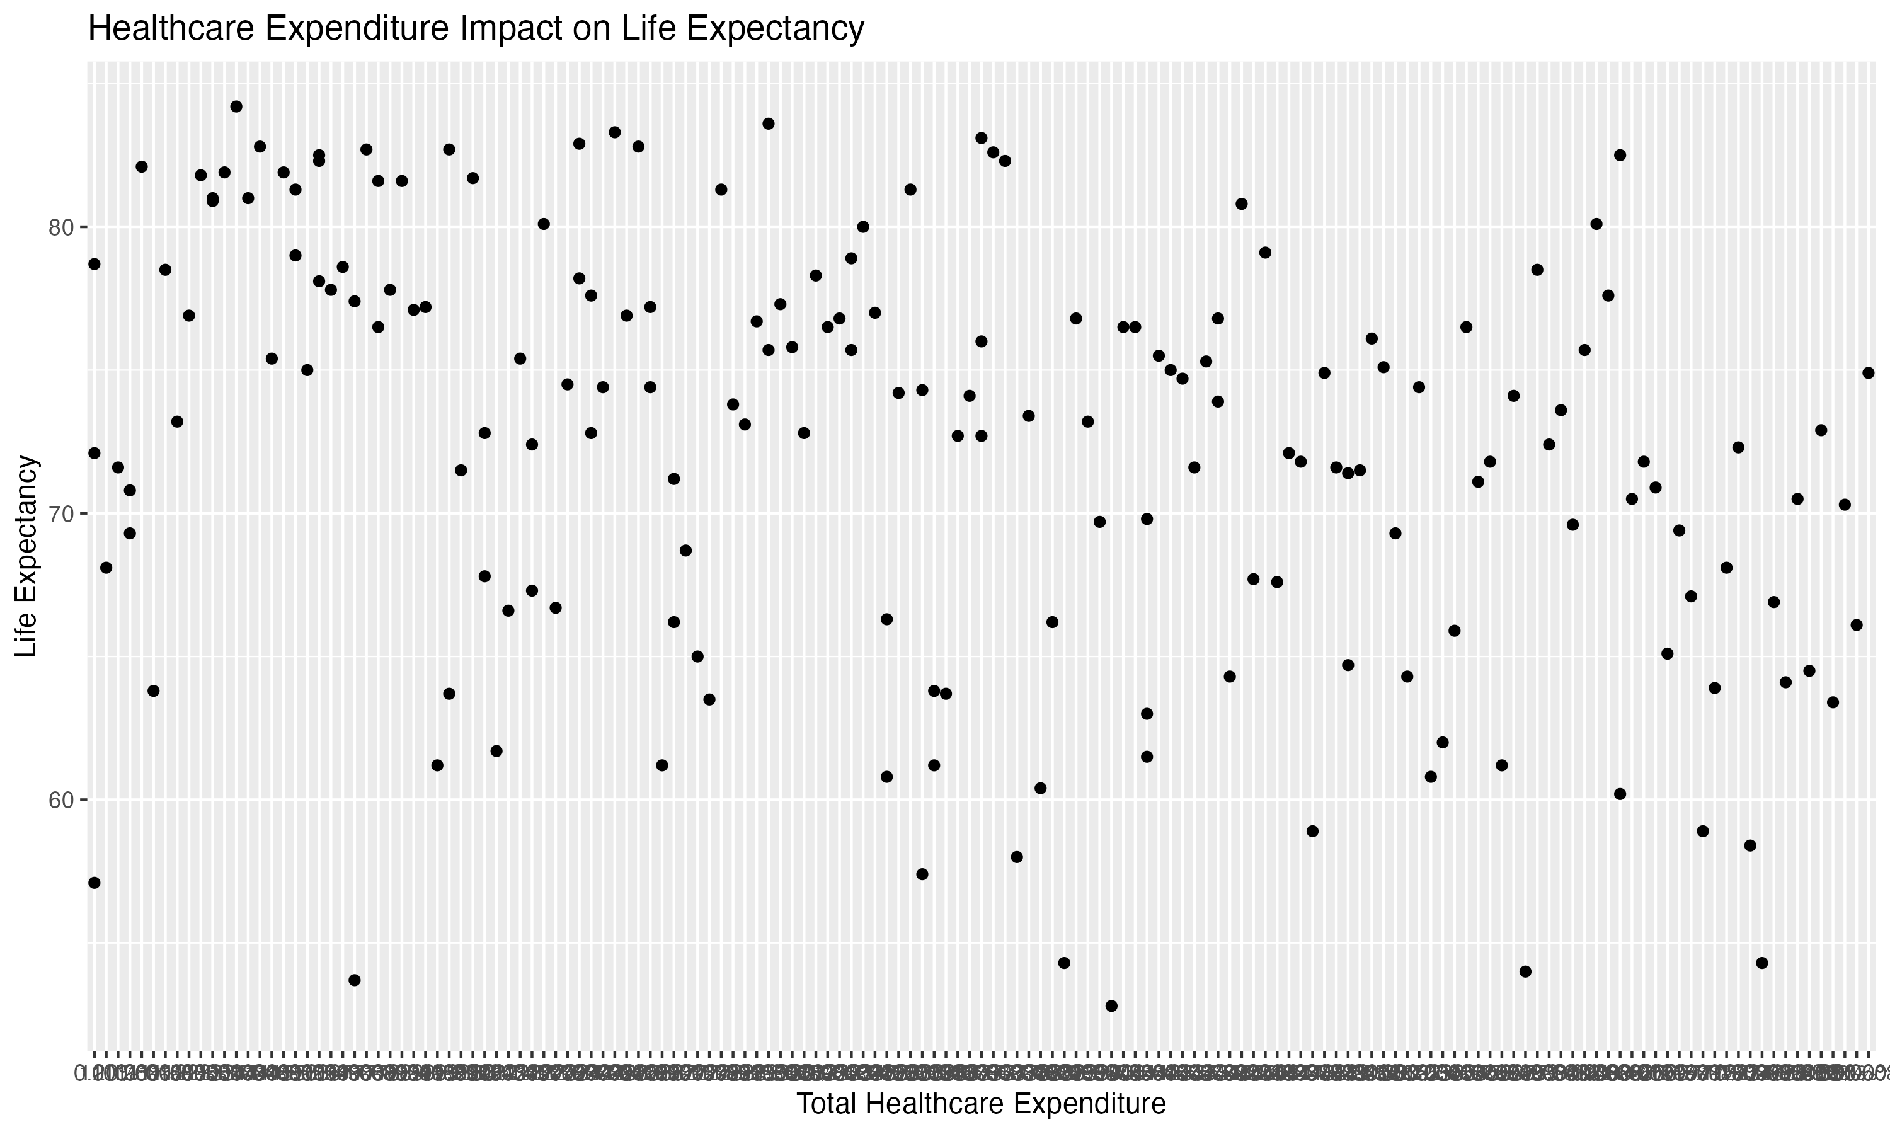
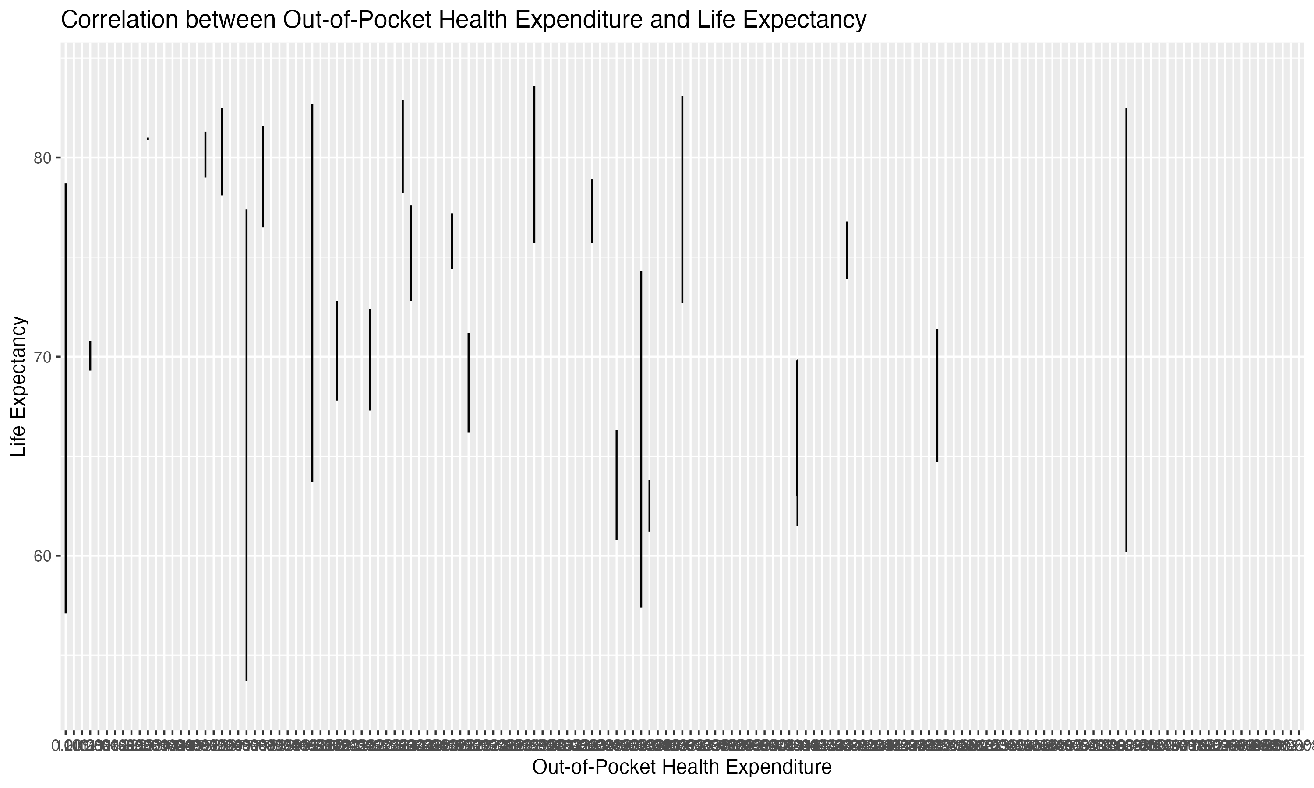
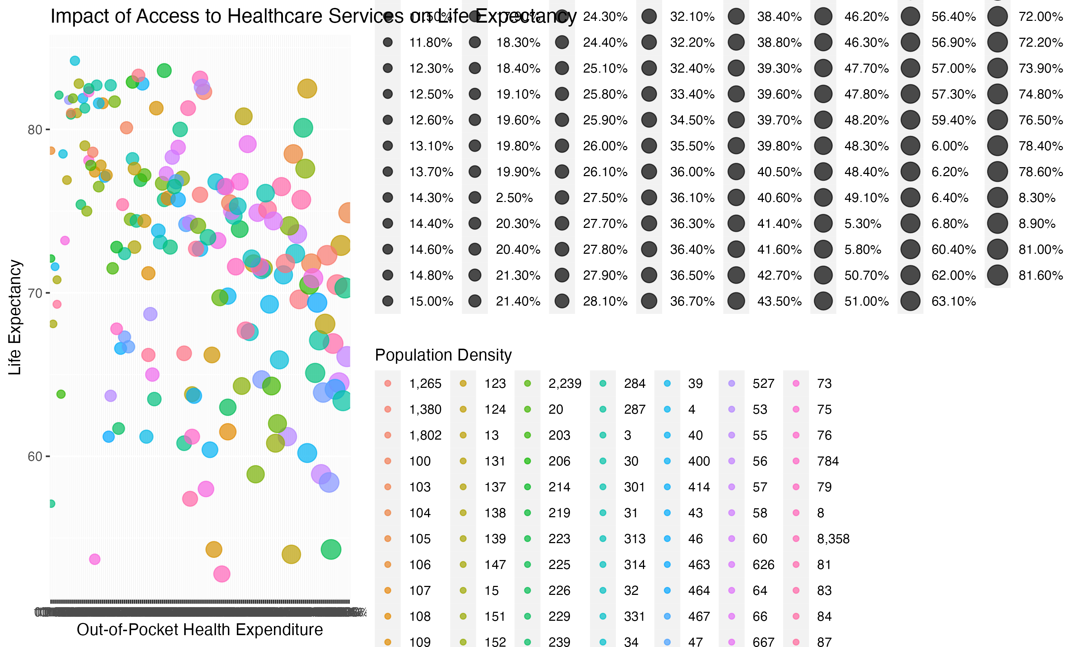
RESEARCH QUESTION 4 : EFFECT OF HEALTHCARE EXPENDITURE ON LIFE EXPECTANCY IN R

Slide 17
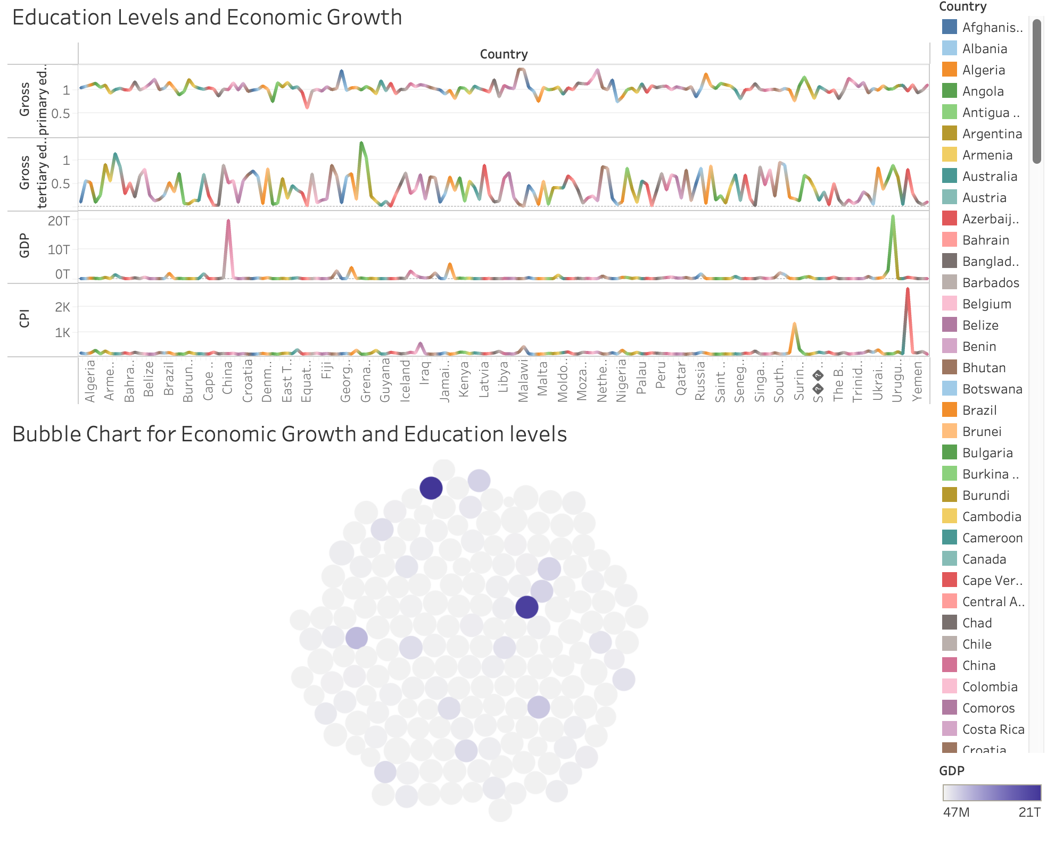
RESEARCH QUESTION 5: RELATIONSHIP BETWEEN EDUCATION LEVELS AND ECONOMIC GROWTH IN TABLEAU

Slide 18
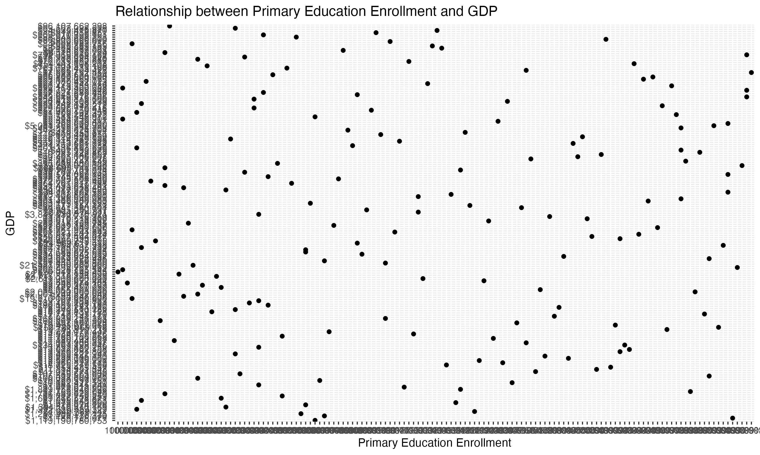
RESEARCH QUESTION 5: RELATIONSHIP BETWEEN EDUCATION LEVELS AND ECONOMIC GROWTH IN R

Slide 19
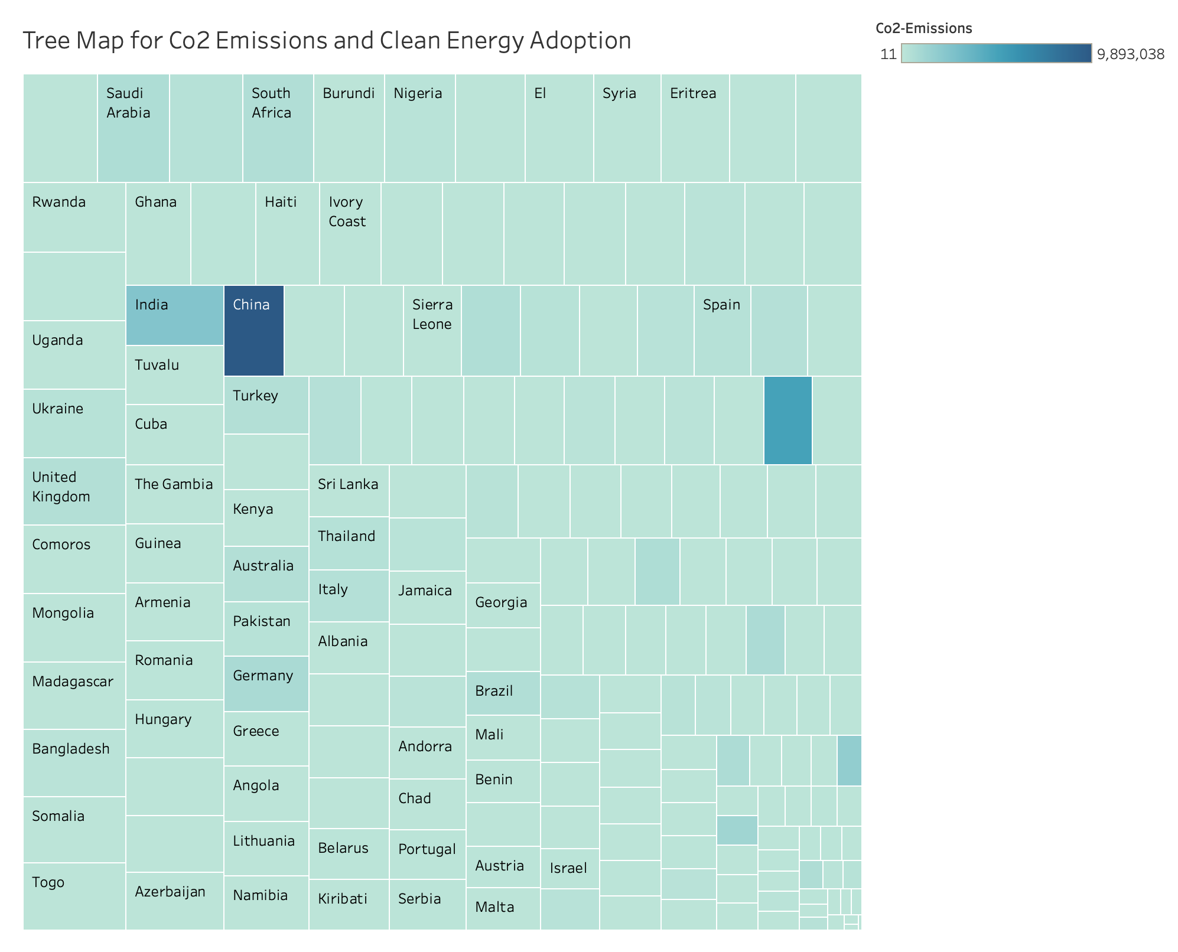
RESEARCH QUESTION 6: FACTORS AFFECTING CLEAN ENERGY ADPTION IN TABLEAU

Slide 20
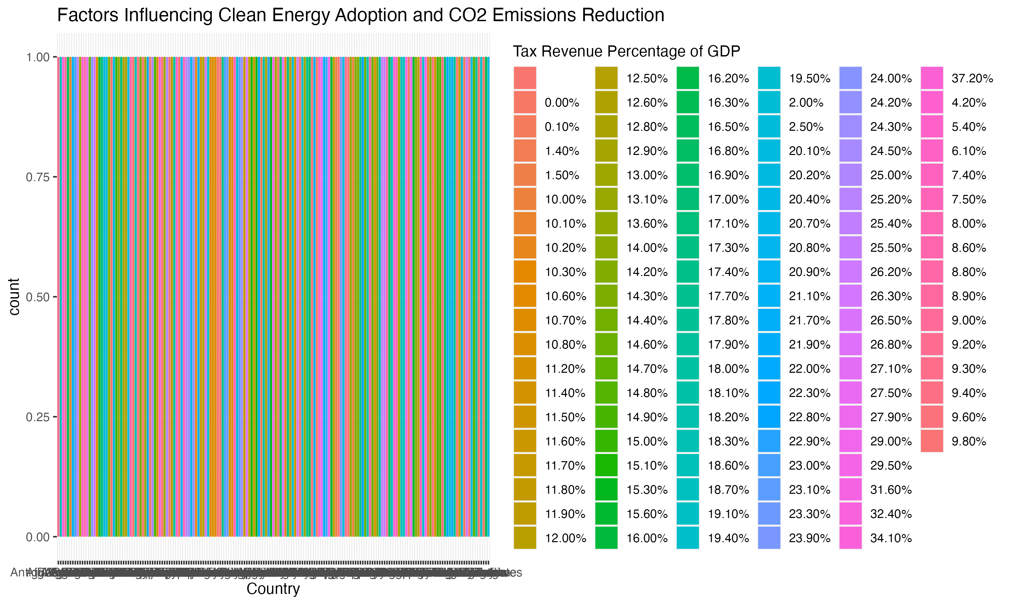
RESEARCH QUESTION 6: FACTORS AFFECTING CLEAN ENERGY ADPTION IN R

Slide 21
CONCLUSION
In summary, our exploration into the intricate tapestry of global development has brought to light the nuanced connections between environmental factors, socioeconomic indicators, and educational dynamics. Utilizing a data-driven methodology, we dissected the complexities steering the paths of nations, with a particular focus on interconnected themes like the environment, demographics, healthcare, and education. Our investigation into the correlations among forested areas, fertility rates, CO2 emissions, and economic indicators uncovered a rich web of interdependencies. Through this unraveling process, valuable insights were gained, providing a deeper understanding of the forces influencing the global socio-environmental and economic landscape. Delving further, our study delved into the profound connection between education and income inequality, offering nuanced perspectives on how educational levels and governmental policies shape wealth distribution within societies. This exploration into educational dynamics not only enhances our comprehension but also underscores the crucial role education plays in forging equitable and thriving societies. The multidimensional approach adopted in this project, encompassing thorough data analysis, dynamic visualizations, and the synthesis of global databases, has made a significant contribution to the discourse on sustainable development. By shedding light on environmental sustainability, demographic transitions, and educational imperatives, we aim to catalyze informed discussions and decision-making on a global scale.

